Slide 1
Using A/B test to increase entire store’s revenue by 5%
Business objective
Chen Cui

Slide 2
What can we do to achieve this goal?

Slide 3
EDA(exploratory data analysis)

Slide 4
Data preprocessing:
Dealing with missing values
Dealing with outliers

Slide 5
Correlation analysis :
Correlation between the metric(s) that we care about and certain product feature/user behaviour

Slide 6
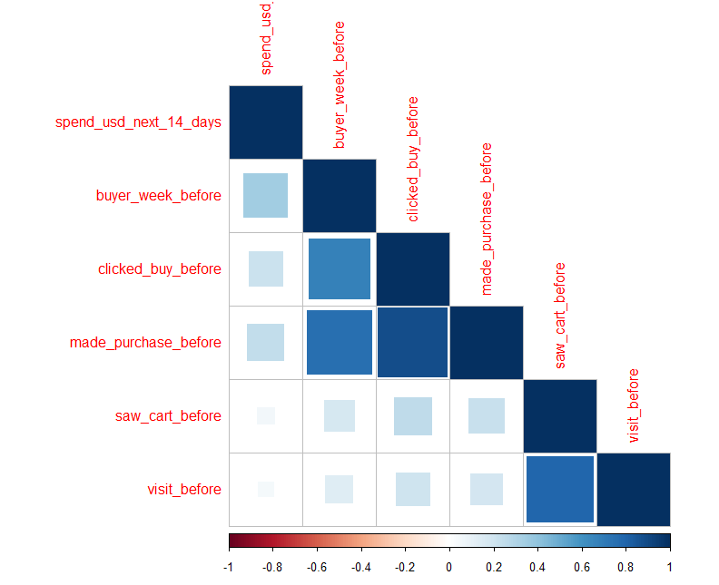
Users that have clicked buy and made purchase before are more likely to spend money in the future than those who only reached shopping cart.

Slide 7
Hypothesis
Based on EDA, we can assume that revenue correlates very much with user’s past purchase flow experience.

Slide 8
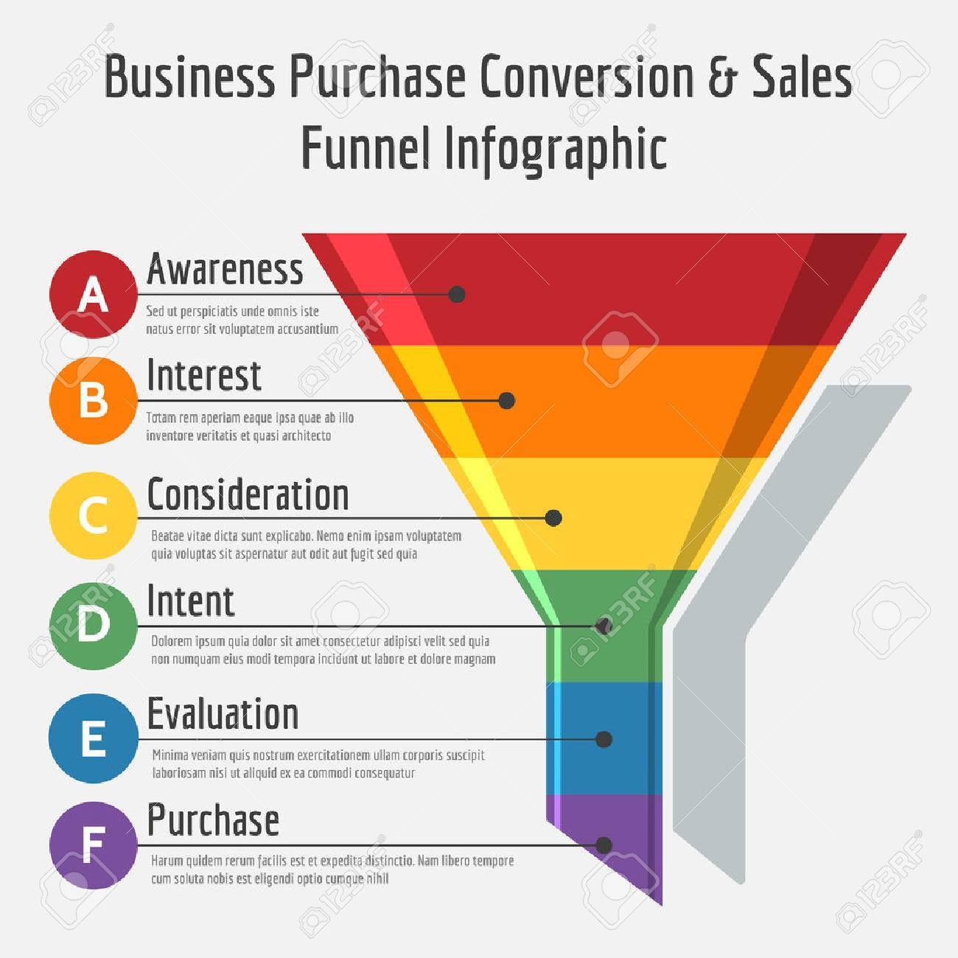
My hypothesis: Pushing users down the funnel as far as possible can increase our revenue. To do this, we can partner with marketing team to send out emails to users that fell off previously.

Slide 9
A/B test
Choose population
Determine sample size
Sampling method
Duration and exposure
Could sending out emails to users who reached shopping cart but haven’t made purchase increase revenue?

Slide 10
Target population
I did A/B test on group of users who has added some items in the shopping cart but did not buy the item in the last 2 months in US.
Choose cohort as population. (Track the same group of users over time.)

Slide 11
Sample Size
Knowing the variance of the population and setting type I error as 5%, in order to achieve a 80% power, and a 5% magnitude of effect,(which is our goal that increasing the revenue by 5%), the needed sample size is 8% of the target population.

Slide 12
Sampling method
Use Simple sampling method to randomly select 4% of the target population as treatment group, and randomly select 4% of the target population as control group.
Duration
20 days.

Slide 13
Approach
In treatment group, we send emails out to the users reminding him/her to buy the product (or offering some discount) and making some recommendations of similar products with lower prices.
Dosage
If the user do not buy the item in 5 days after receiving the email, we send email again to him or her. Then if he or she still do not make a purchase in 9 days after the second email, we send the email again.

Slide 14
Results

Slide 15
Our experiment shows a statistic significant result:
Compared to control group, the email campaign on treatment group has a positive impact on revenue ,which is a 6% increment.

Slide 16
Recommendations

Slide 17
Turn it on
We focus on revenue growth and the email campaign will likely to increase the revenue by 6%
Schedule of ramp up: go to 50% of target population on Tuesday, go to 100% of target population on next month.
Roll out to more markets: e.x. Europe.
Continue to track the secondary metrics like conversion rate.
Other interesting ideas in the pipeline: about payment methods.

Slide 18
Thanks!

